Slide 1
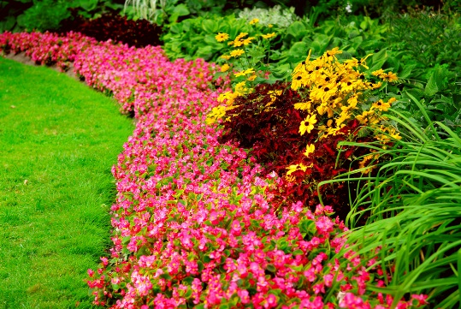
Green Scene
Student Name

Slide 2
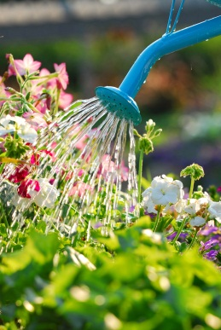
Green Scene Services
Lawn Mowing, Triming & edging
Aeration, fertilization, weed control
We also do Spring and Fall Clean-up
Tree, shrub, and Flower service

Slide 3
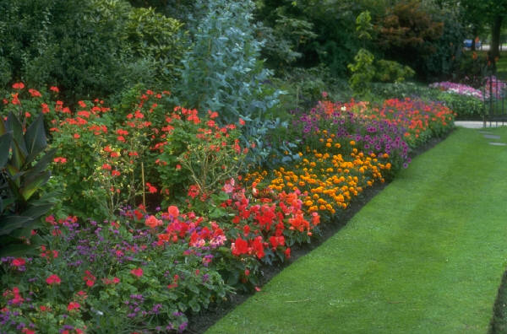
Lawn Mowing, Trimming & Edging
Mowing
Once a week
One-third the length at a time
Trimming and Edging
Along foundation and fence line
Blowing to remove debris

Slide 4
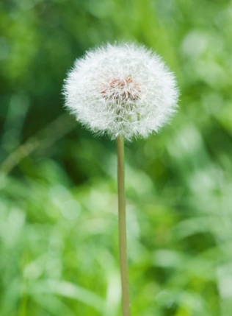
Aeration, Fertilization, Weed Control
Aeration
It relieves soil compaction
Increase water infiltration
Fertilization
I use Natural based, granular fertilizers
Includes lawn, trees, shrubs
Weed Control
Apply broadleaf weed control
Includes surface insect control

Slide 5
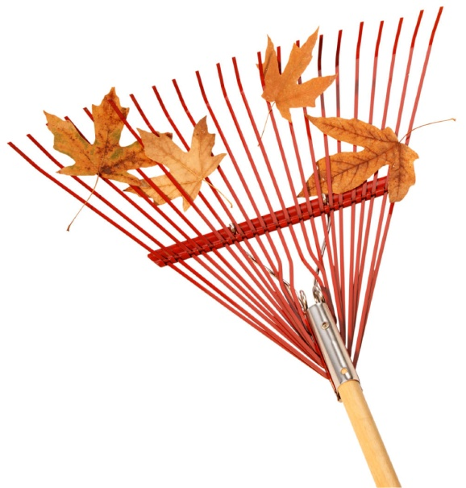
Spring and Fall Clean-Up
Spring Clean-Up
Remove winter debris
De-thatch lawn
Restock mulch beds
Fall Clean-Up
I can emove fall leaves
Seed and mulch bare soil patches

Slide 6
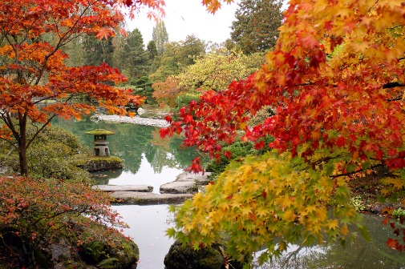
Tree and Shrub Service
Let me Trim or remove trees and shrubs
Treat or protect from disease
Remove tree stumps

Slide 7
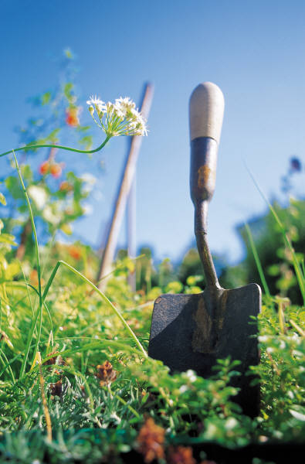
Call today for a free estimate!
Student Name
Student Telephone Number

